Slide 1
The Training of Composite Inspection
By Rob Bilney (TESTIA Ltd)
Notes:
1
Brief Personal Intro

Slide 2
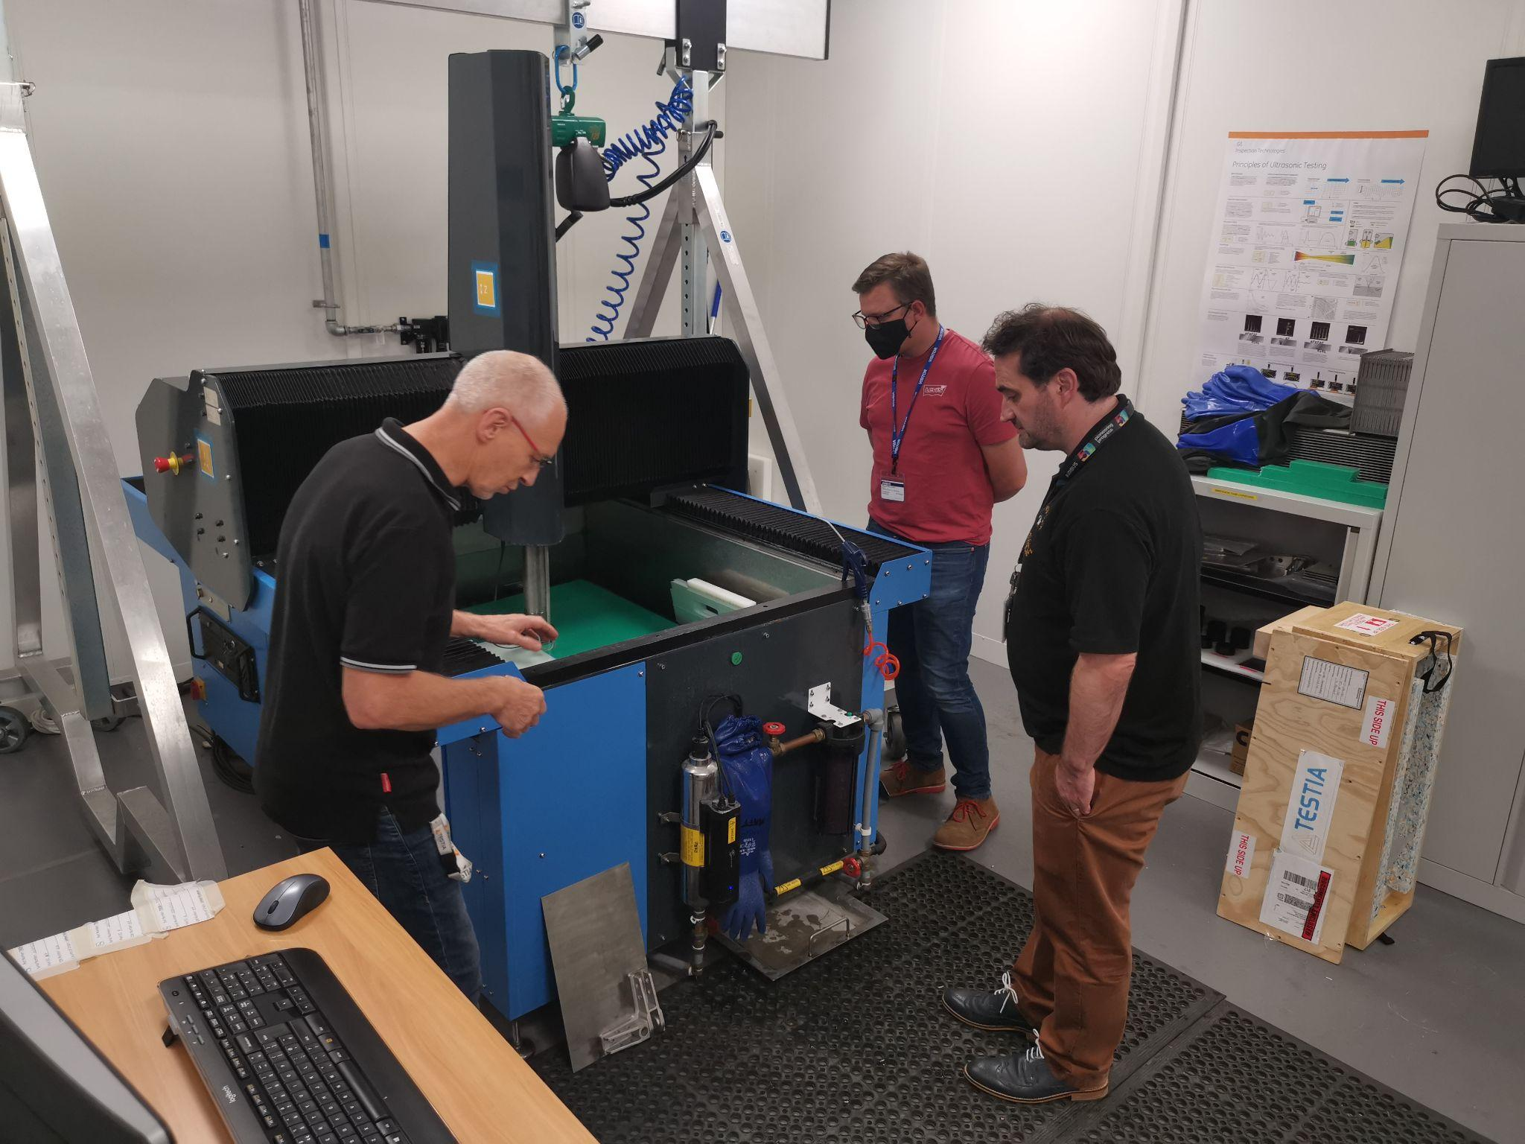
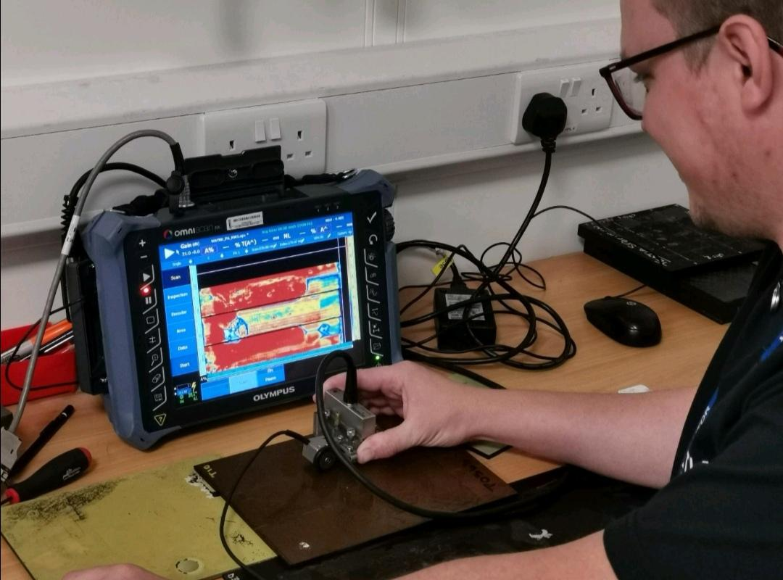
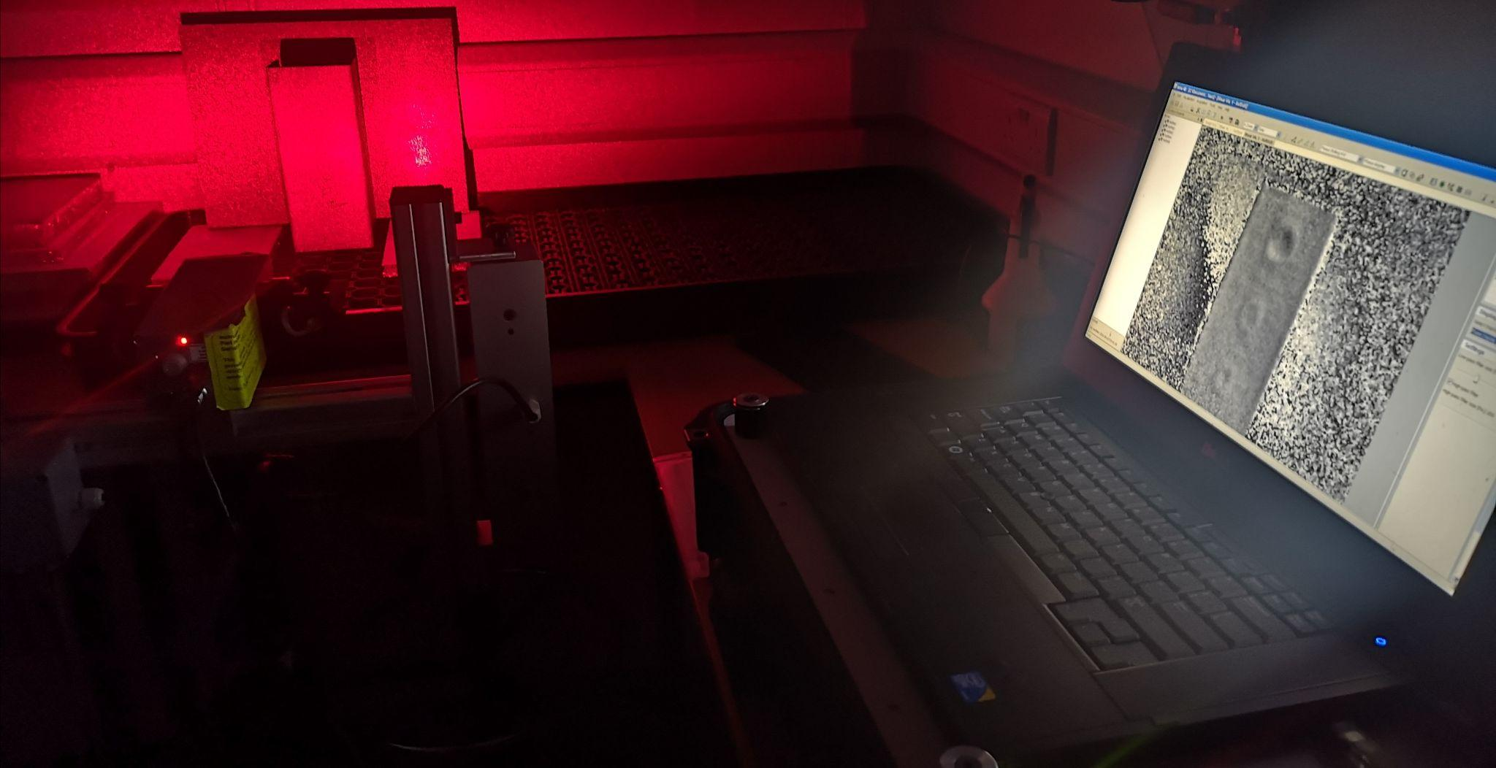
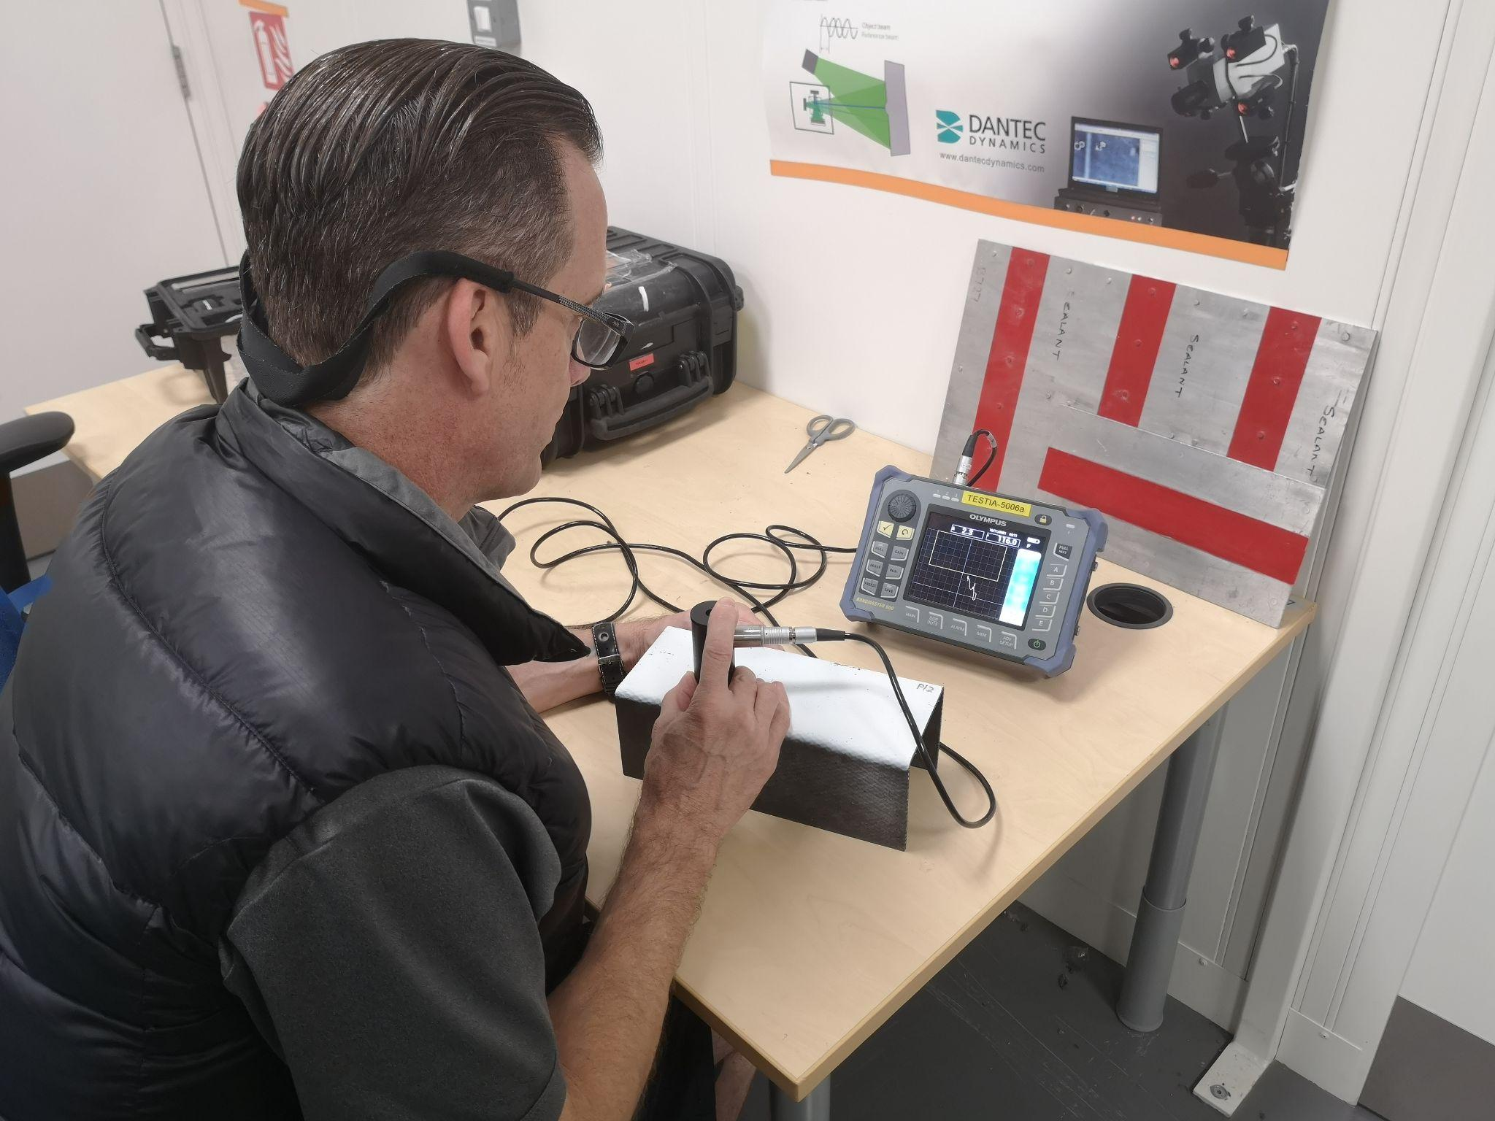
How we inspect composites
Conventional UT/Immersion
Phased Array UT
Laser Shearography
Bond Testing
Notes:
2
How we inspect composites
Composite inspection poses an interesting challenge due to the varying performances from different composite constructs and the shear range of possible composite combinations. It makes sense to align the inspection requirement with the most cost effective method that yields the requisite results.
As such, composite training needs to capture this wide diversity of methodology available enabling the student, when qualified, to make informed decisions based on a solid understanding of theory and experience of practical applications across a range of materials.
That being said, no one can know everything, I know people who come very close, a few here present, but I can never profess to doing so. It is often the case that when a more specialist avenue has been selected that further exploration is necessary.

Slide 3
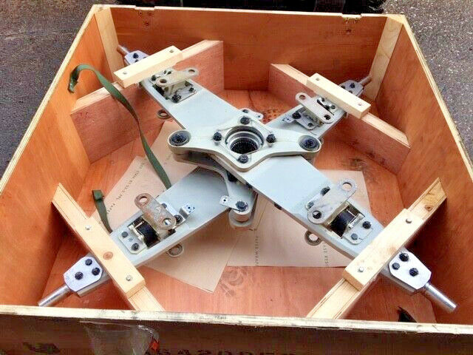
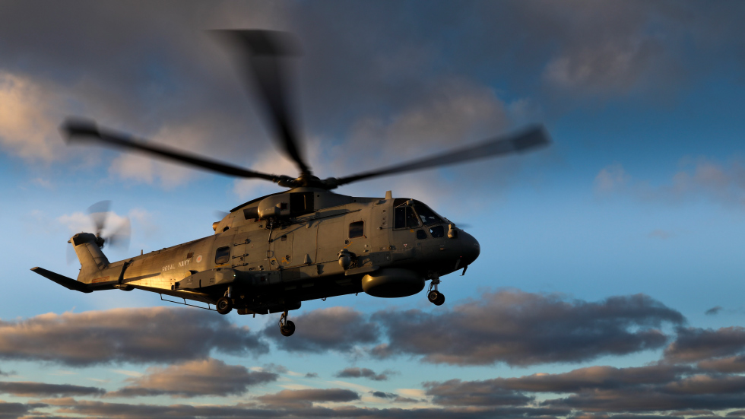
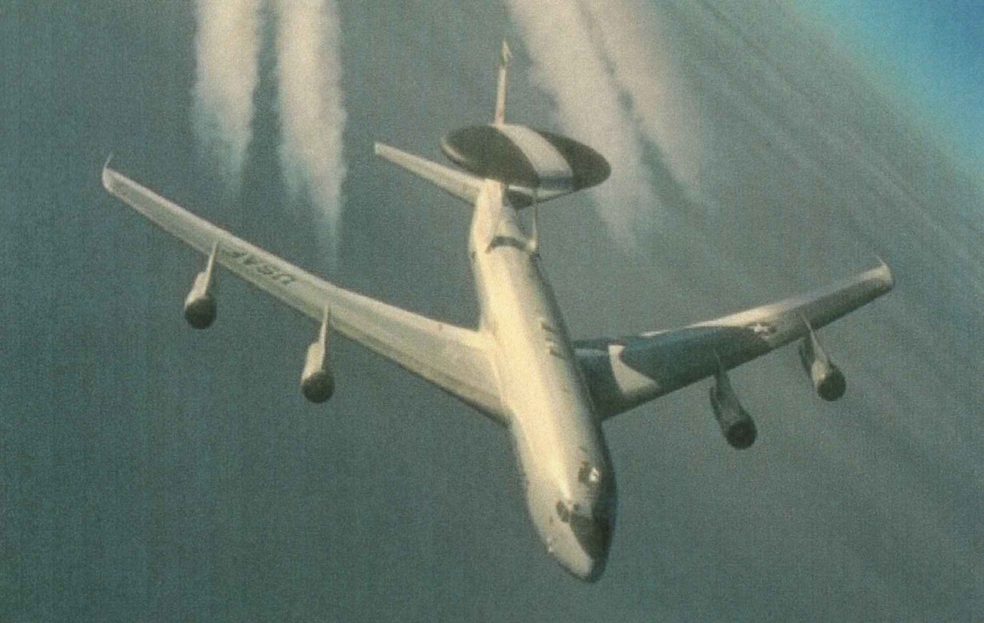
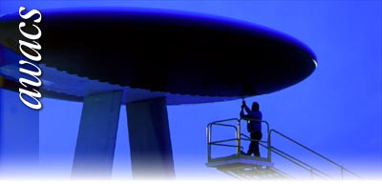
INFORMED DECISIONS- A Hammer to Crack a Walnut?
Notes:
3
Training and experience help make informed decisions. On one hand there is the story of the elastomeric bearing housing for the Merlin tail rotor composite half hub, where the world and their dog was thrown at it and the resultant inspection was a tap hammer. On the other hand there was the expanse of the just retiring Sentry E-3Ds rotor dome where simple battery power tap testers were used until Laser Shearography was applied, reducing inspection time by a factor of ten with a corresponding increase in sensitivity and POD. As it’s the most relevant to Marine Composite Inspection we are going to explore the makeup of our Laser Shearography Level 2 course.

Slide 4
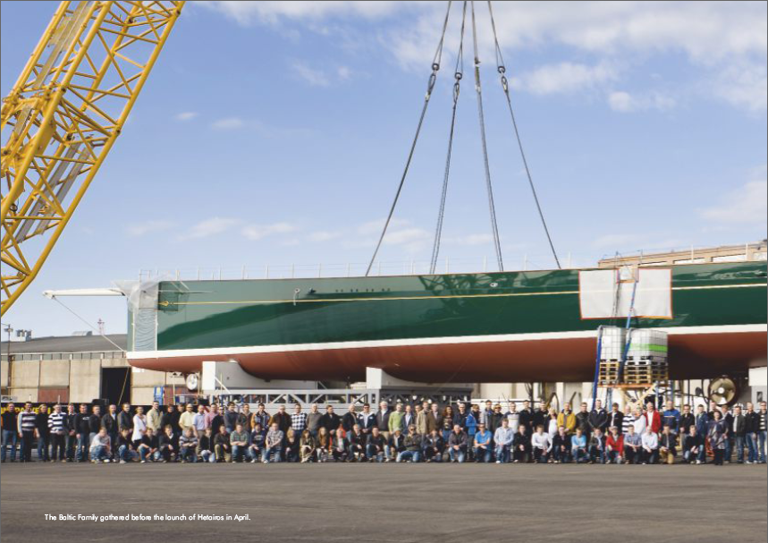
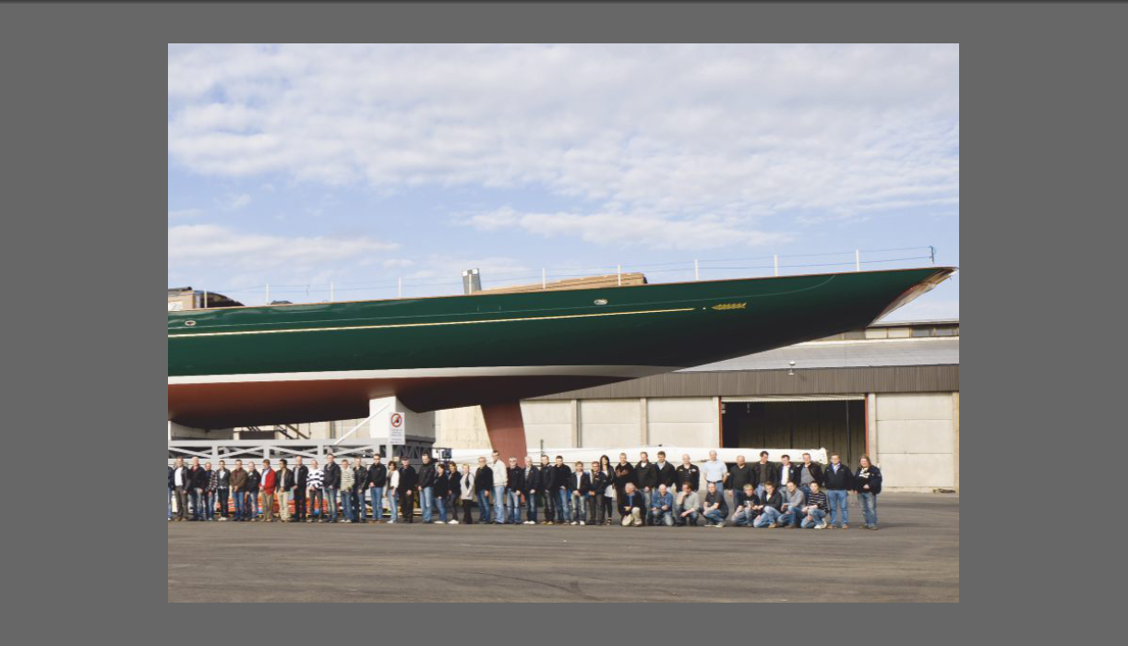
SIZE IS NO PROBLEM
Carbon Fibre to Nomex and Foam Core Sandwich 97 metre
Panamax Project ( Hetarios) - Baltic Yachts, Jacobstad, Finland
Image courtesy of R.Gregory ST L3
Notes:
4
One of the benefits of ST, that truely offsets the expense is the vast expanse of area that can be covered for a given inspection. Reducing dry dock time and getting seabound sooner. An understanding of this technology is covered elsewhere over the two days, so I wish to briefly talk about how a training course is developed and some of the key areas, where it can be tailored and delivered to meet specific requirements.

Slide 5
Devising a curriculum - Laser Shearography
Module 1
Introduction to NDT- Other Methods (Informed Choices Again)
Introduction and overview of Shearography Testing
An overview of some of the equipment variations
Certification
Module 2
Underpinning Theory
Light
Basic Optics
Lasers and Laser Safety
Notes:
Main points
The teaching areas, derived from the BINDT or governing body curriculum, in the form of Learning aims or Training objectives. These should give a sound underpinning of the theory behind the method. These objectives are further subdivided into steps that will achieve the learning objective, called enabling objectives.
In the case of ST, these include an understanding of the properties and behaviour of light, extending to an understanding of the fundamentals of LASERs and their safety.
Also, as ST is camera based, there should be an understanding of the principles of camera and lens operation.

Slide 6
Devising a curriculum - Laser Shearography
Module 3
Specialist and Specific Areas
Speckle Interferometry
Holography
Shearography
Phase Stepped Shearography
Module 4
Application of the theory
Inspection Sensitivity
Materials Concepts
Composites
Notes:
6
Then we explore the specifics of ST operation, looking at how systems have developed; as due to the expense, older systems are still in use. Whilst having access to the latest cutting edge equipment, we still maintain and use our older equipment; as quite simply...it works. Although in fairness, we can be scraping around for 3.5” disc nowadays.
We can't assume that everyone through our doors has a background in composites, so we complete a module covering basic composites before getting into the nitty gritty of applying our theory in real-life and attaining the best results possible. This will always be a mix of fully understanding the equipment, the method principles and how we best represent and then locate the type and size of defects sought.

Slide 7
Devising a curriculum - Laser Shearography
Module 5
More Specific Application
Stressing methods
What is the best way? Is it practicable for you and your company?
Module 6
Application of the theory
Inspection Factors
Analysis
Technique Writing
Notes:
7
There is a balance between the best methodology for the job and what you have and what you can get. Additional stress methods add expense and also need to be quantifiable, so there can be a tendency to try and force fit the task with available equipment. This is the case in ST as it is in any other NDT discipline.
Inspection factors are numerous and include:
Shearing, Stressing, Stability, Illumination, Camera settings, Environmental aspects
Image interpretation, Validation of Technique parameters, Representative defect samples
Analysis, needs to cover variations of any classic indications, what may constitute a false positive? Need an underlying knowledge of the structure.

Slide 8
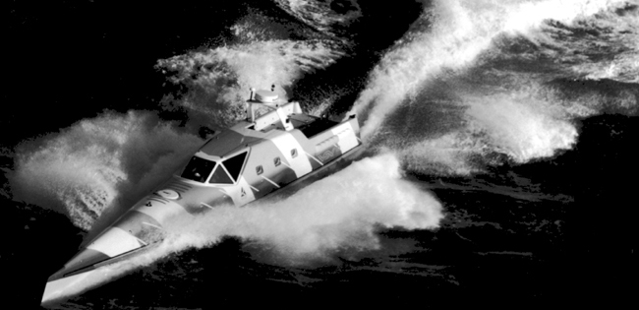
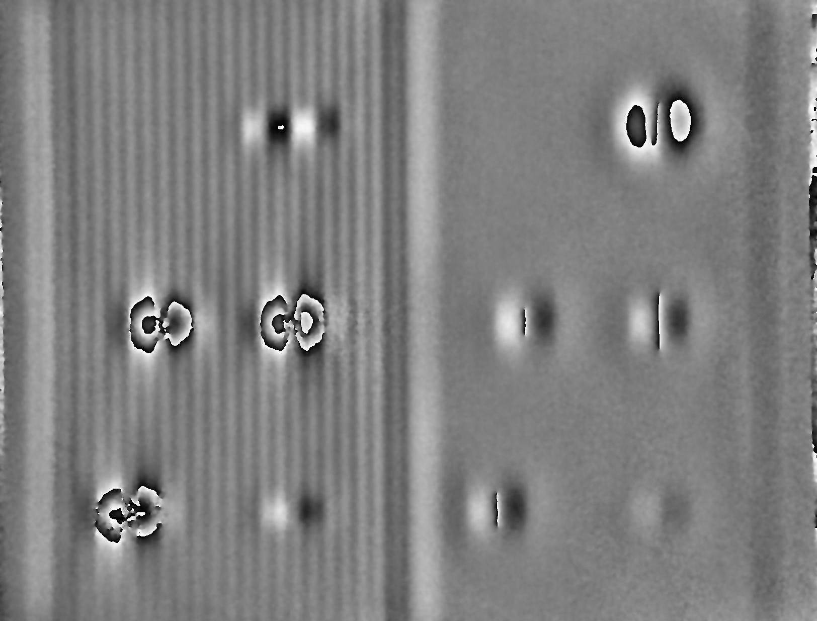
Practical Application for the Method and the Customer
Inspection Applications
Technique Development
Technique Mind Maps
The Reference Standard is King/Queen!
Notes:
8
17 Meter Severn and the 14 Meter Trent Class lifeboats
for RNLI FRP to Rigid Foam Core.
Encourage people to bring components on courses and events such as this, but ST as with many other NDT methods, is not a search tool. It may not be the best suited method or it may require a degree of exploratory work to establish the best settings and method of stressing the component.
Ultimately, the reference standard is king, so an insight into how these can be developed using the available facilities is an invaluable course addition.

Slide 9
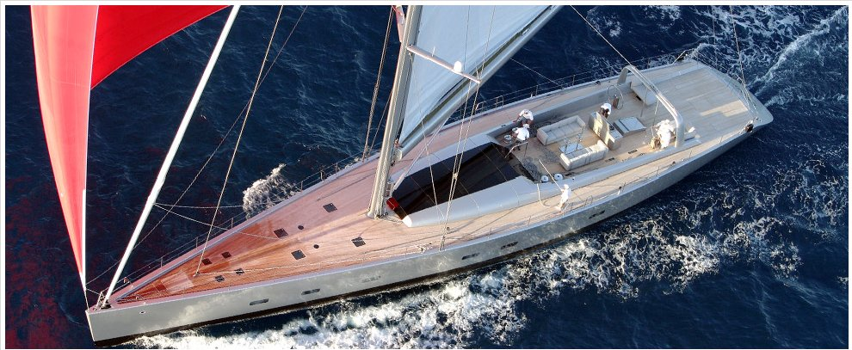
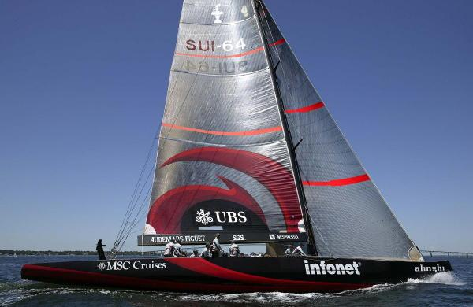
Thank you for your time!
Images courtesy of R.Gregory ST L3
Notes:
9
Training is quite a complex makeup and should be always best utilising time instead of sometimes filling it. Knowledge should be imparted in ways best suited to the learning styles of people as individuals within time and facility constraints. Ultimately learning should be an enjoyable and not stressful experience. Summative and formative assessment should be valid with well designed and worded papers and exercises.

